Slide 1
Team : theBoys
Project 40: Peacock eye counting

Slide 2
Understanding:
So, we will be given an image of a peacock and we have to count the number of ocelli(s) in the feathers of it.
The problem lies in the category of problems where we identify as well as count the occurance of a specific object in image. What we will basically do is match parts of the edge detections of uploaded image to a circular boundary and mark the boundary wherever the pattern matches.

Slide 3
Current Progress:
We are able to count as well as display the eyes in the peacock’s image.
The labelling obtained is very accurate and matches the actual location of spots.
We are also able to display the margin of the eye in the output.
Some ocelli which lie on the boundary or are partly hidden by the peacock’s neck are also detected.

Slide 4
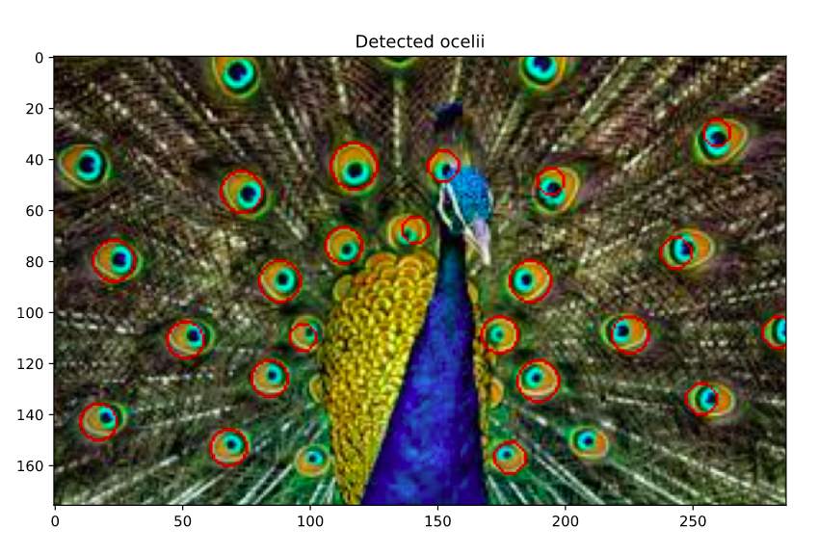
Outputs:
The ocelli that were detected are marked by Red circles.
Parameters can be changed further to get more/less ocelli.

Slide 5
How we did it?
Used Canny edge detector to detect edges. Used Otsu's method to get the upper and lower threshold parameters.
Detection of eyespots is done using Circular Hough transformation. Used Scikit image transform library functions: hough_circle and hough_circle_peaks for detecting circles in the output of canny filter

Slide 6
How we did it?
The number of the ocelli detected is the size of the output of previous functions.
Then added the circles for the output to original image again using the scikit image function circle_perimeter.

Slide 7
Problems:
Some ocelli are elliptical in shape. Our algorithm only detects almost perfectly circular ocelli.
Can be solved using Elliptical Hough transformation which also handles the elliptical edges (but takes a lot of time for detection 😞)
Canny detector also shows a lot of feathers in the edges which also affect the ocelli and gives ambiguous results sometimes.
Can be solved by taking median/gaussian blur first, then some adaptive thresholding and then ellipse/circle detection.

Slide 8
Thanks.
Team members:
Astitva Gupta , 2018101085 Kartik Agarwal, 2018102017 Ayan Biswas, 2019121009 Priyanshu Madaan, 2018101097

